Slide 1


INTRODUCTION TO DATA VISUALIZATION
DATA VIZ
Chart types, data types, and preparing data before you draw
Lecture 1 of 6 · Data Visualization · 3rd year, Data Science · Lebanese University
Notes:
Welcome the students. This course has 6 lectures of 1.5 hours each plus lab sessions, for 25 contact hours in total. Today's goal: build the vocabulary (data types, chart types, visual encodings) and the habit of cleaning data before visualising it.

Slide 2
Course roadmap
# | Lecture | Lab / practice | Deliverable
1 | Introduction: chart types, data types, preprocessing | Notebook 01: cleaning messy data | Lab 1
2 | Power BI I: ecosystem, Power Query, modelling, DAX | Lab A: CSV to first report | Lab A .pbix
3 | Power BI II: Python in Power BI, ETL, pros and cons | Lab B + Notebook 05 | Power BI project
4 | Python viz: Matplotlib, Seaborn, Plotly | Notebooks 02, 03, 04 | Labs 2–4
5 | Smart dashboards I: concepts, elements, architecture | Notebook 06: Dash in Colab | Lab 6
6 | Smart dashboards II: full-stack project, case studies | Project workshop + demos | Final project
9 h of lectures + 16 h of guided labs = 25 h. All notebooks run in Google Colab with no installation.
Notes:
Explain the rhythm: every lecture is followed by hands-on lab time. Students who miss a lab can still complete the Colab notebooks on their own, because each notebook is self-contained.

Slide 3
How you will be assessed
30%
20%
30%
20%
Labs (6 notebooks + Power BI labs)
Power BI project (Lecture 3)
Final smart-dashboard project (team of 2–3)
Written exam: concepts and chart critique
Labs: graded on correctness and on chart quality (titles that state a finding, honest axes, readable labels).
Projects: a real or realistic Lebanese dataset is encouraged (public health, energy, retail, telecom, education).
Notes:
This weighting is a suggestion. Adapt it to the faculty's rules. Emphasise that chart quality is graded, not only code that runs.

Slide 4
Why visualize?
01
Summary statistics can hide the story that a picture reveals instantly

Slide 5


Two jobs of a chart: explore vs. explain
Exploratory (for you)
Explanatory (for others)
Goal: discover patterns, outliers, errors
Many quick charts, rough styling
Audience: the analyst
Tools: pandas .plot, Seaborn, Power BI drafts
Question: "What is in this data?"
Goal: communicate one clear message
Few polished charts, deliberate design
Audience: managers, public, decision makers
Tools: Matplotlib with annotations, Plotly, dashboards
Question: "What should they know or do?"
Notes:
Most student charts fail because an exploratory chart is shown as if it were explanatory. In explanatory charts, the title should state the finding, for example 'Weekend sales are 30% higher', not 'Sales by day'.

Slide 6








How we see: pre-attentive attributes
The brain detects these in under 250 ms, before conscious attention. Use them to make the message pop.
Position
Length
Colour hue
Intensity
Most accurate. Basis of bar, line and scatter charts.
Bars must start at zero to be honest.
For categories. Max 6–8 distinct hues.
For ordered values (sequential palettes).
Size / area
Shape
Angle / slope
Enclosure
Bubbles, treemaps. Area is often misjudged.
Secondary category in scatter plots.
Pie slices and line slopes: less accurate.
Boxes and shading group related items.
Notes:
Demonstration: show a grid of grey dots with one red dot, and students find it instantly. Then show one dot that is slightly larger: much harder. Hue is strong for categories, but not for quantities.

Slide 7
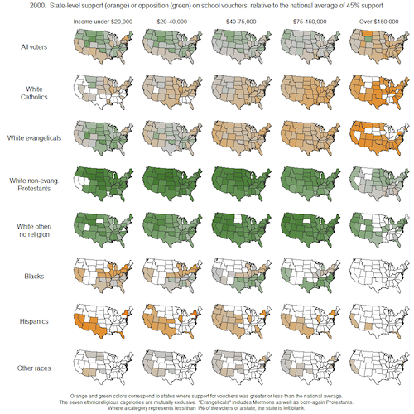
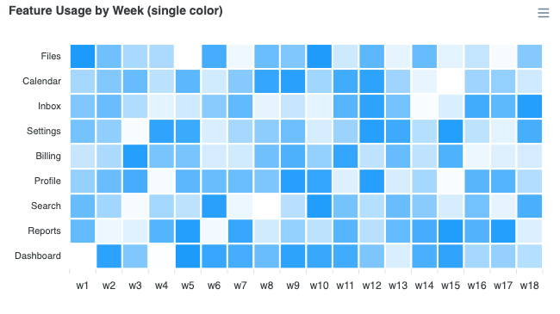
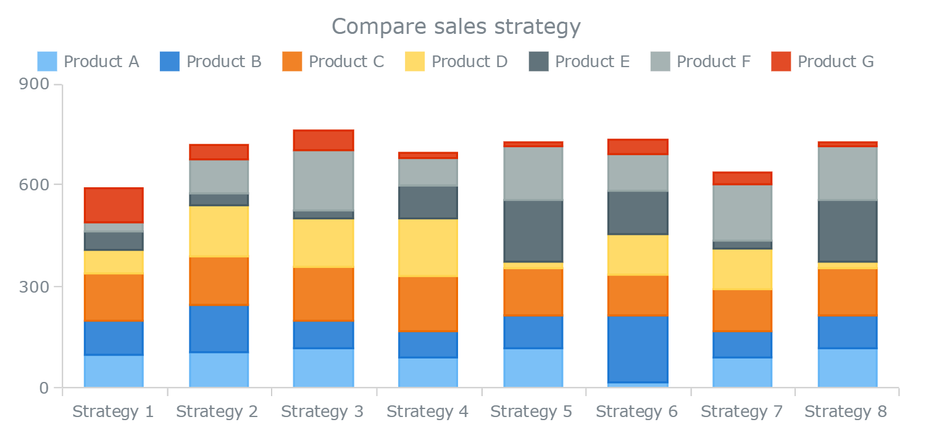
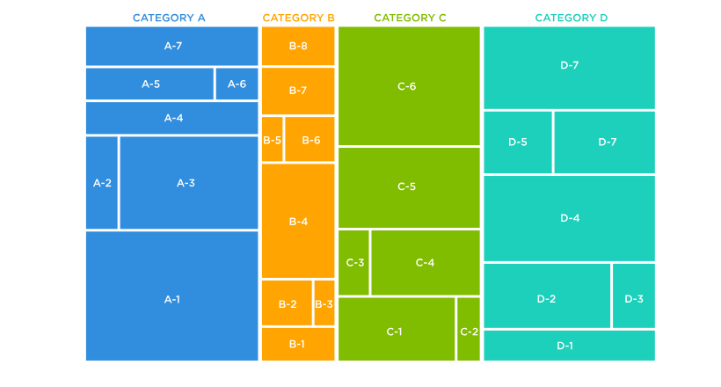
Ranking of visual encodings (Cleveland & McGill)
1. Position on a common scale (bar chart, dot plot)
2. Position on non-aligned scales (small multiples)
3. Length, direction (stacked bars)
4. Angle, slope (pie, donut)
5. Area (bubbles, treemap)
6. Volume, curvature (3D charts)
7. Colour saturation and hue (heatmaps, choropleths)
Notes:
Cleveland & McGill (1984), 'Graphical Perception', JASA. This is why a bar chart almost always beats a pie chart for precise comparison. Heatmaps are still useful for spotting patterns in large matrices, where precision matters less.

Slide 8
Types of data
02
The type of a variable decides which charts, operations and colours are valid

Slide 9
Levels of measurement (Stevens' typology)
Type | Definition | Lebanese examples | Valid operations | Good encodings
Nominal | Categories, no order | Governorate, bank, phone operator (Alfa / Touch) | =, ≠, count, mode | Hue, shape, position
Ordinal | Ordered categories, unequal gaps | Satisfaction (low → high), university year | <, >, median | Ordered position, sequential colour
Interval | Equal gaps, no true zero | Temperature (°C), calendar year | +, −, mean | Position, line
Ratio | Equal gaps and a true zero | Revenue, age, kWh used, students per class | ×, ÷, %, all of the above | Length, position, area
Temporal | Time stamps (special interval) | Daily exchange rate LBP/USD, order date | Resample, lag, trend | x-axis of line charts
Trap: postcodes and student IDs are numbers, but they are nominal. Never average them or plot them on a continuous axis.
Notes:
Ask students to classify: 'GPA', 'blood type', 'floor number', 'income bracket'. Discuss why 'twice as hot' makes no sense in °C (interval), while 'twice the revenue' does (ratio).

Slide 10
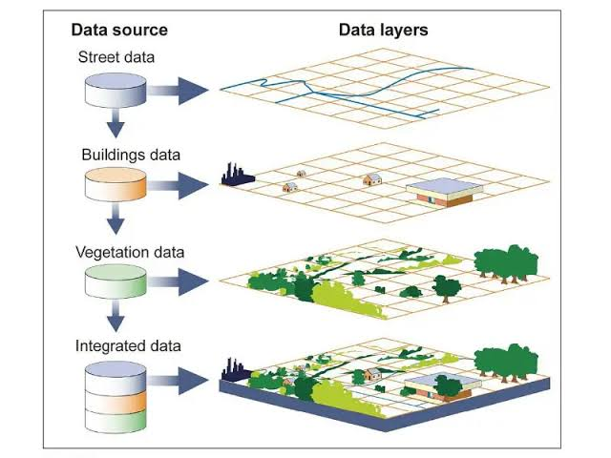
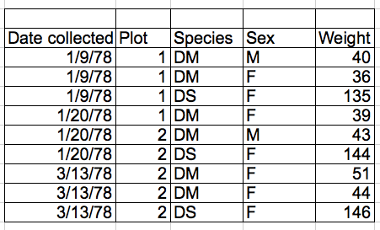
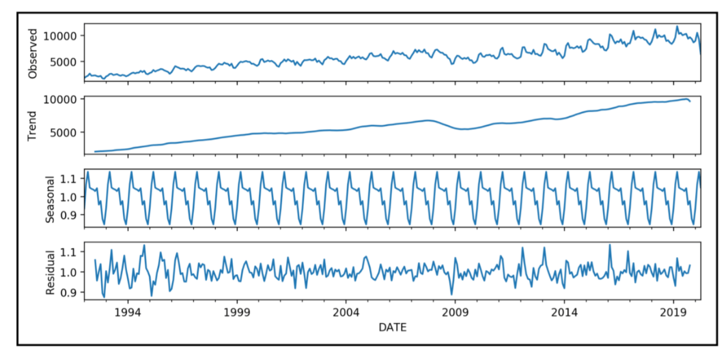



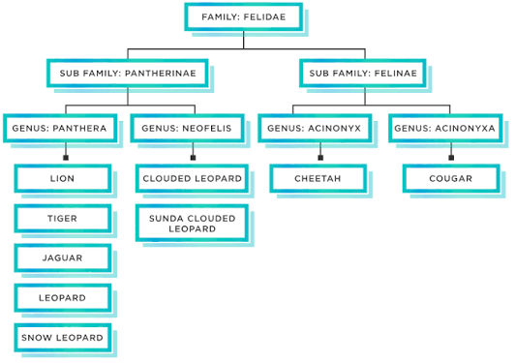
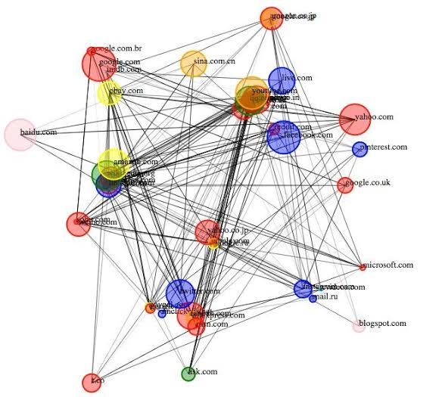


Beyond columns: common data structures
Tabular
Time series
Geospatial
Rows = observations, columns = variables. Bars, scatter, histograms.
Ordered by time. Line, area, calendar heatmap, sparkline.
Coordinates or regions. Choropleth, point map, flow map.
Hierarchical
Network
Text
Parent-child (governorate > district > town). Treemap, sunburst.
Nodes + edges (social, flights). Node-link graph, chord, Sankey.
Reviews, tweets. Word frequency bars, topic charts (avoid word clouds).
Notes:
The data structure often matters more than the column types. For example, a table of trips becomes a network once you see origin to destination. Word clouds are popular but inaccurate (word length distorts size), so prefer bar charts of term frequency.

Slide 11
Choosing the right chart
03
Start from the question, not from the chart type

Slide 12
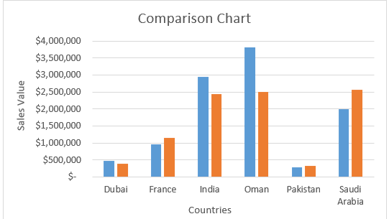
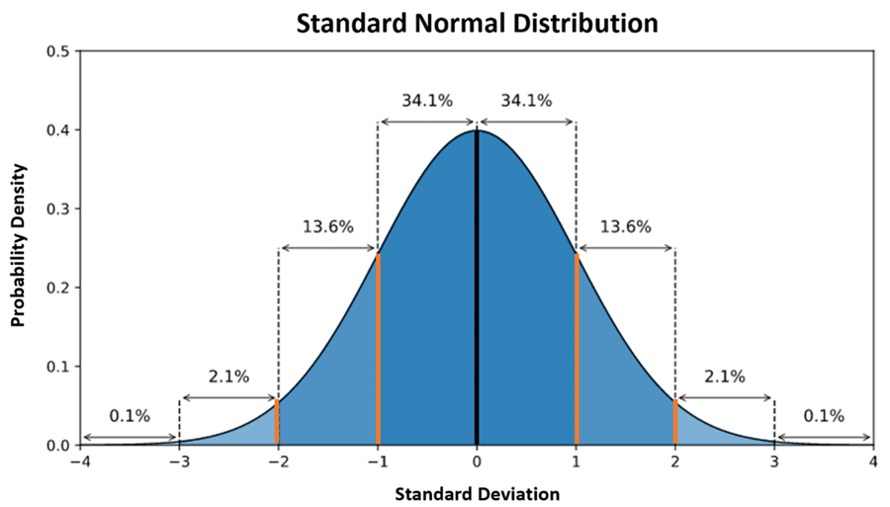



Six analytical tasks, six chart families
Comparison
Distribution
Composition (part-to-whole)
Bar, column, dot plot, lollipop, bullet chart
Histogram, box plot, violin, density, ECDF
Stacked bar, 100% bar, treemap, waterfall (pie only for 2–3 parts)
Relationship
Trend over time
Geography
Scatter, bubble, correlation heatmap, pair plot
Line, area, slope chart, sparkline, candlestick
Choropleth, symbol map, hex map, flow map
Notes:
Ask: 'What is the verb of the question?' Compare, distribute, compose, relate, change or locate. The verb points to the family.

Slide 13
Chart gallery (1): native charts you will build in every tool
Bar / column
Compare categories (1 cat + 1 num)
Line
Trend over time (time + num)
Scatter
Relationship (2 num)
Doughnut / pie
Part-to-whole, only 2–3 parts
Stacked column
Composition across groups
Area
Cumulative volume over time
Bubble
3 numeric variables (x, y, size)
Radar
Profile on several criteria (use sparingly)
Notes:
All of these are native PowerPoint, Excel and Power BI charts, so students can re-create them anywhere. For each one, ask: how many variables does it show, and of which type?

Slide 14
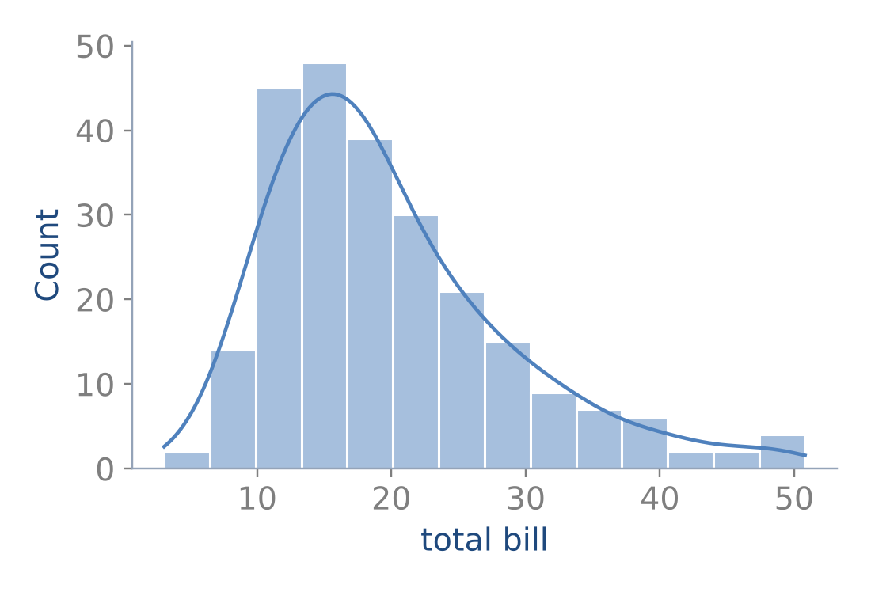
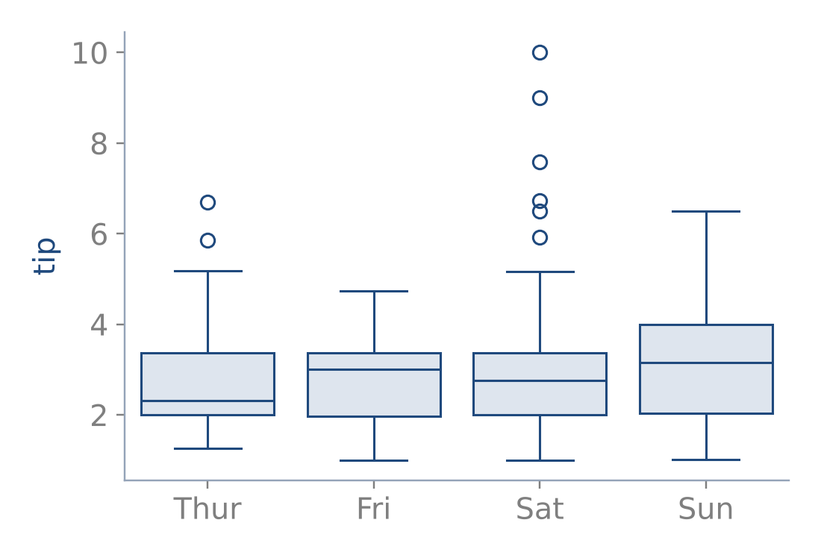
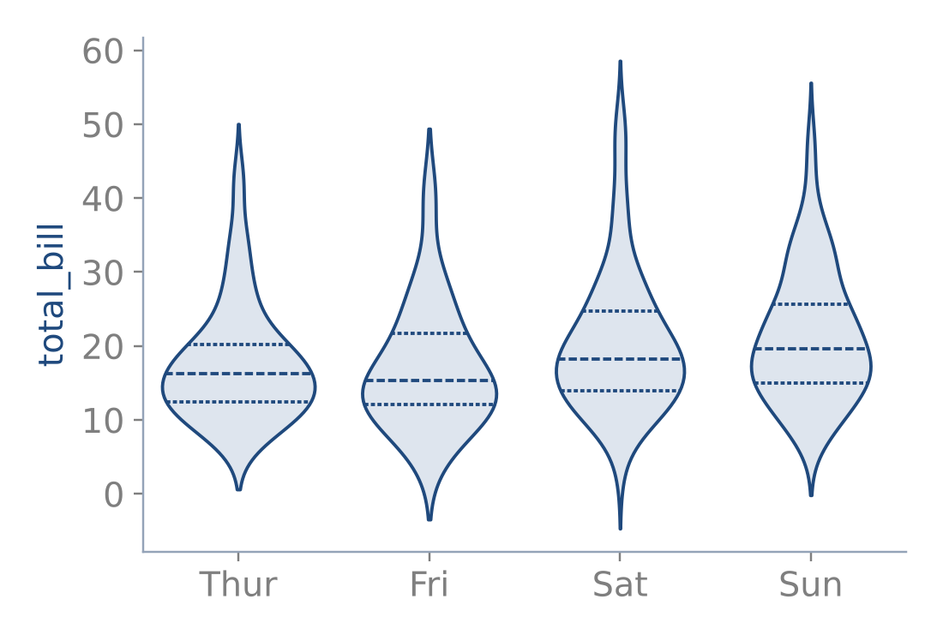
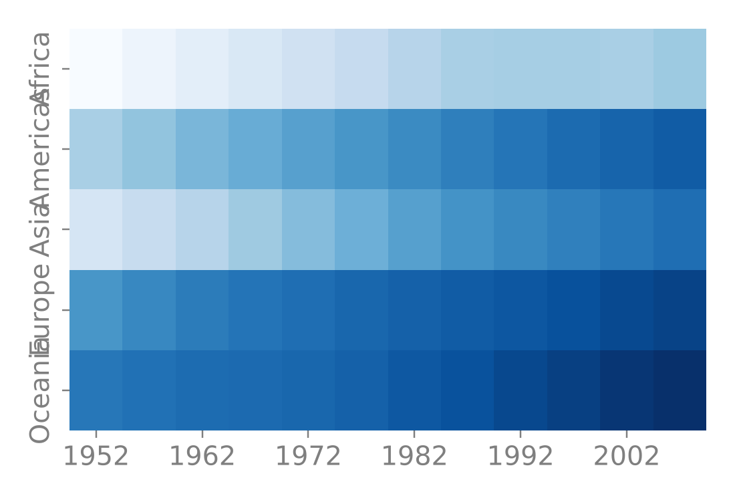
Chart gallery (2): statistical charts for distributions and matrices
Histogram + density
Shape of one numeric variable
Box plot
Median, quartiles, outliers per group
Violin
Full distribution per group
Heatmap
2 categories + 1 value (matrix)
Notes:
These come from Seaborn (Lecture 4). Box plots summarise five numbers. Violins show the full density, including bimodality that a box plot hides. Heatmaps work for large matrices such as continent by year.

Slide 15
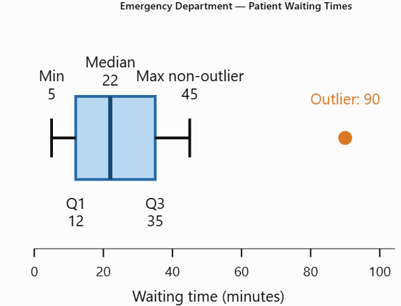


Box plots
How did we identify the outlier?
First calculate the interquartile range:
IQR=Q3-Q1=35-12=23
Then calculate the lower and upper outlier boundaries.
Lower fence=12-1.5(23)=-22.5
Upper fence=35+1.5(23)=69.5
Any waiting time above 69.5 minutes is classified as a potential outlier.
Because patient P15 waited 90 minutes:
90>69.5
Patient ID | Waiting time (minutes)
P01 | 5
P02 | 8
P03 | 10
P04 | 12
P05 | 15
P06 | 18
P07 | 20
P08 | 22
P09 | 25
P10 | 28
P11 | 30
P12 | 35
P13 | 40
P14 | 45
P15 | 90
Therefore, P15 is a statistical outlier. The upper whisker stops at 45 minutes, which is the largest actual waiting time within the permitted boundary.
Q3=35 minutes
Interpretation: Approximately 75% of patients waited 35 minutes or less.

Slide 16
Which data does each chart need?
Chart | Variables needed | Best for | Avoid when
Bar / column | 1 categorical + 1 numeric | Ranking, comparing groups | More than ~20 categories (use top-N)
Line | 1 temporal/ordered + 1 numeric (+ group) | Trends, seasonality | Categories have no order
Histogram | 1 numeric (binned) | Shape, skew, modes | Very few observations (< 30)
Box / violin | 1 numeric + 1 categorical | Comparing distributions | Audience unfamiliar with quartiles
Scatter | 2 numeric (+ colour, size) | Correlation, clusters, outliers | Overplotting: use alpha or hexbin
Heatmap | 2 categorical/ordinal + 1 numeric | Patterns in matrices | Precise value comparison is needed
Pie / donut | 1 categorical (2–3 levels) + share | Simple part-to-whole | Many slices, comparing similar sizes
Choropleth | Region + 1 numeric (rate) | Spatial patterns | Raw counts (normalise by population)
Notes:
This is the key reference table for the course and for the exam. Choropleth trap: mapping raw counts mostly shows where people live. Always map rates (per capita, per km²).

Slide 17
Same data, two charts: which one lets you compare?
Pie: angles are hard to compare
Is Zahle larger than Saida? Hard to tell.
Sorted bar: position on a common scale
The ranking and the differences are obvious.
Notes:
Live quiz: show the pie first and ask students to rank the five branches. Then reveal the bar chart. This connects back to the Cleveland & McGill ranking.

Slide 18
Honest axes: a truncated axis can triple a difference
Truncated axis (starts at 95)
B looks about 3x larger than A. Misleading for bars.
Zero-based axis
The real difference: about 3%.
Notes:
Rule: bar and area charts must start at zero, because length encodes the value. Line charts may zoom in, because position and slope are what is read, but say so clearly. Read: Alberto Cairo, 'How Charts Lie'.

Slide 19
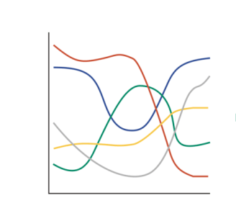
Other common mistakes to avoid
3D effects: distort length and angle, and hide data behind other data
Dual y-axes: any correlation can be faked by rescaling one axis
Rainbow / jet colour maps: not perceptually ordered, and unreadable for colour-blind viewers
Too many categories: group into the top 7 + "Other"
Spaghetti lines: use small multiples, or highlight one line and grey the rest
Unsorted bars: sort by value unless the categories have a natural order
Missing context: no units, no source, no time period, no baseline
Notes:
Show one bad example from local media if you have one, for example a 3D pie chart from a news site. Students enjoy critiquing real charts.

Slide 20
Colour with purpose: three types of palettes
Qualitative
Sequential
Diverging
Distinct hues, no order. For nominal data (branches, operators). Keep to 8 colours or fewer. Examples: Tableau10, Set2, 'colorblind'.
Light to dark in one hue. For ordered or ratio data (income, density). Examples: viridis, Blues, mako.
Two hues around a meaningful midpoint (0, average, target). For change and correlation. Examples: RdBu, vlag, coolwarm.
Notes:
A good default: use grey for everything, and one accent colour for the thing you want the audience to look at. This is the 'highlight' strategy from Storytelling with Data (Knaflic).

Slide 21
Preprocessing before visualization
04
Garbage in, misleading chart out

Slide 22


The data preparation pipeline for visualization
01
02
03
04
05
06
Collect & load
Profile
Clean
Transform
Aggregate & reshape
Visualize
Read CSV, Excel, SQL, API
Check encoding (Arabic text: UTF-8)
info(), describe()
Missing values, duplicates
Count categories
Fix types
Unify labels
Handle missing values and outliers
Derive columns
Date features
Bin, normalise, log
Choose the grain
groupby, pivot, melt
Encode
Annotate
Check against the raw data
Rule of thumb: about 70% of the time in a visualization project is spent before the first chart.
Notes:
Walk through each step with the electronics-store dataset used in Notebook 01. Stress profiling: never draw before you have run info(), describe() and isna().sum().

Slide 23
Data problems and how they distort charts
Problem | What goes wrong in the chart | Typical fix (pandas)
Dates stored as text | Axis sorted alphabetically (01/02, 01/03…) | pd.to_datetime(col, format="%d/%m/%Y")
Inconsistent labels | "Beirut", "beirut ", "BEIRUT" become 3 bars | str.strip().str.title()
Duplicated rows | Inflated counts and sums | drop_duplicates()
Missing values | Gaps in lines, biased means | dropna / fillna(median) / flag column
Sentinel values (999, -1) | Extreme points squash the axis | replace(999, np.nan)
Data-entry outliers | One bar dwarfs the others | IQR rule, domain check, fix or drop
Wrong grain | Noisy daily chart, or over-aggregated | resample("W"), groupby
Different scales | Small series look flat | Index to 100, log scale, small multiples
Notes:
Each row maps to a section in Notebook 01. In the lab, students reproduce each 'wrong' chart and then fix it.

Slide 24
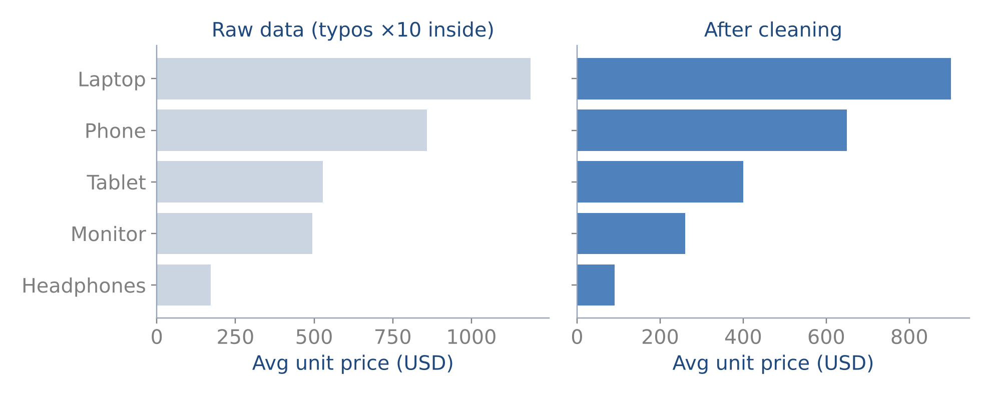
Cleaning changes the story
What happened?
25 prices had an extra zero (×10)
The averages were inflated by 30–90%
Fix: values > 5× the product median were divided by 10
Document every cleaning decision
Average unit price per product, before and after cleaning (Notebook 01)
Notes:
Ask students: should we drop or fix the outliers? Here we know the cause (a typo), so fixing is better than dropping. If the cause were unknown, flagging and reporting them would be the honest choice.

Slide 25
Cleaning in pandas: a minimal recipe
python
Copy first: never modify the raw data in place
errors="coerce" turns bad values into NaN instead of crashing
Flag before imputing: missingness can itself be a pattern
Median, not mean, for skewed variables such as income or age
df = raw.drop_duplicates().copy()
# types
df["order_date"] = pd.to_datetime(
df["order_date"], format="%d/%m/%Y")
df["quantity"] = pd.to_numeric(
df["quantity"], errors="coerce")
# labels
df["branch"] = (df["branch"].str.strip()
.str.title().fillna("Unknown"))
# sentinel + missing (keep a flag!)
df["age"] = df["age"].replace(999, np.nan)
df["age_missing"] = df["age"].isna()
df["age"] = df["age"].fillna(df["age"].median())
Notes:
Live-code this in Colab. Show df.info() before and after so students see the dtype changes.

Slide 26
Outliers and reshaping: long vs. wide
python
Long / tidy: one row per observation. Seaborn, Plotly Express and Power BI prefer it
Wide: one column per category. Heatmaps and matplotlib loops prefer it
Outliers: decide between error (fix or drop) and real extreme (keep and annotate)
# IQR rule, per group
def iqr_flags(s, k=1.5):
q1, q3 = s.quantile([.25, .75])
i = q3 - q1
return (s < q1 - k*i) | (s > q3 + k*i)
df["out"] = (df.groupby("product")["price"]
.transform(iqr_flags))
# long (tidy) -> wide, and back
long = (df.groupby(["month", "branch"])
["revenue"].sum().reset_index())
wide = long.pivot(index="month",
columns="branch", values="revenue")
back = wide.reset_index().melt(id_vars="month")
Notes:
Tidy data (Hadley Wickham, 2014): each variable is a column, each observation is a row. Power BI's 'Unpivot columns' in Power Query is the same operation as melt.

Slide 27
Transformations that make charts readable
Aggregate to the right grain
Bin continuous variables
Daily data → weekly or monthly with resample(). Choose the grain that answers the question: the operational view is daily, the strategic view is monthly.
pd.cut(age, [0, 24, 34, 44, 54, 120]) gives age groups. pd.qcut gives quantile bins of equal size.
in (minutes) | Patients | Percentage
0–<20 | 6 | 40.0%
20–<40 | 6 | 40.0%
40–<60 | 2 | 13.3%
Normalise to compare
Smooth noisy series
Index = 100 at the start, z-score, per-capita rates, or a log scale for data spanning orders of magnitude (GDP, population).
A rolling mean (7 or 30 days) shows the trend. Keep the raw series faint in the background for honesty.
Notes:
Connect each card to a cell in Notebook 01, sections 4 to 6.

Slide 28

Lab 1: clean a messy dataset, then visualize it
Open Notebook 01 in Google Colab (File › Upload notebook).
Profile the raw data: list every quality problem you find.
Clean step by step: duplicates, types, labels, missing values, outliers.
Exercise 1: fix the ×10 price typos instead of dropping them.
Exercise 2: 100% stacked bar of revenue share by product per quarter.
Exercise 3: is missingness in ratings related to product?
Submit the notebook with a short markdown note on each cleaning decision.
Lab: 2.5 hours
Files
notebooks/student/
01_Data_Preprocessing_
for_Visualization.ipynb
Output:
electronics_sales_clean.csv
Notes:
Students need only a Google account. The instructor version with solutions is in notebooks/instructor/.

Slide 29


Key takeaways
Always plot your data
Data type decides the chart
Statistics can hide structure (Anscombe).
Nominal, ordinal, interval, ratio, temporal.
Start from the question
Clean before you draw
Compare, distribute, compose, relate, trend, locate.
Types, labels, duplicates, missing, outliers, grain.
Notes:
Next lecture: Power BI. Ask students to install Power BI Desktop (Windows) before the session, or to use the lab PCs.

